Slide 1
Integer Overflow Vulnerability
Chester Rebeiro
Indian Institute of Technology Madras
http://phrack.org/issues/60/10.html

Slide 2
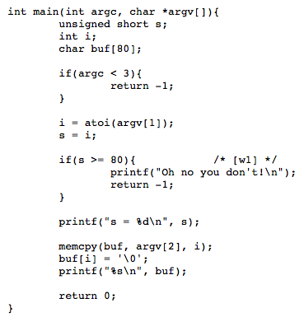

What’s wrong with this code?
Expected behavior

Slide 3
What’s wrong with this code?
Defined as short. Can hold
a max value of 65535
If i > 65535, s overflows, therefore is truncated. So, the condition check is likely to be bypassed.
Will result in an overflow of buf, which can be used to perform nefarious activities

Slide 4
Integer Overflow Vulnerability
Due to widthness overflow
Due to arithmetic overflow
Due to sign/unsigned problems

Slide 5
Widthness Overflows
Occurs when code tries to store a value in a variable that is too small (in the number of bits) to handle it.
For example: a cast from int to short
int a1 = 0x11223344;
char a2; short a3; a2 = (char) a1;
a3 = (short) a1;
a1 = 0x11223344
a2 = 0x44
a3 = 0x3344

Slide 6
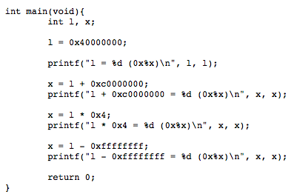

Arithmetic Overflows

Slide 7
Arithmetic Overflows

Slide 8
Arithmetic Overflows

Slide 9
Arithmetic Overflows

Slide 10
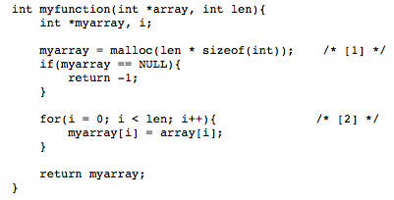
Exploit 1 (manipulate space allocated by malloc)
Space allocated by malloc depends on len. If we choose a suitable value of len such that len*sizeof(int) overflows,
then,
myarray would be smaller than expected
thus leading to a heap overflow
which can be exploited

Slide 11
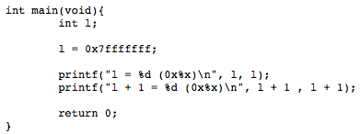

(Un)signed Integers
Sign interpreted using the most significant bit.
This can lead to unexpected results in comparisons and arithmetic
l is initialized with the highest positive value that a signed 32 bit integer can take.
When incremented, the MSB is set, and the number is interpreted as negative.

Slide 12
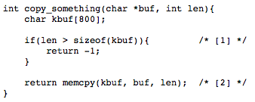
Sign Interpretations in compare
This test is with signed numbers.
Therefore a negative len will pass the ‘if’ test.
In memcpy, len is interpreted as unsigned.
Therefore a negative len will be treated
as positive.
This could be used to overflow kbuf.
From the man pages
void *memcpy(void *restrict dst, const void *restrict src, size_t n);

Slide 13
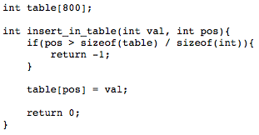

Sign interpretations in arithmetic
If table + pos is greater than entries in table then return -1
If pos is negative, this is not the case.
Causing val to be written to a location beyond the table
This arithmetic done considering unsigned

Slide 14
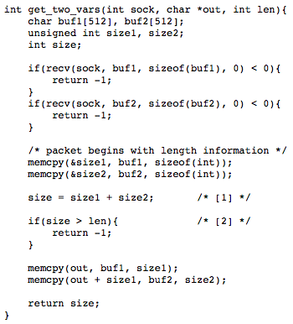
exploiting overflow due to sign in a network deamon
size1 and size2 are unsigned
Size is signed.
if size1 and size2 are large enough,
size may end up being negative.
Size is returned, which may cause an out to overflow in the callee function

Slide 15

Ponder about
#define MAX_BUF_SIZE 64 * 1024
void store_into_buffer(const void *src, int num)
{
char global_buffer[MAX_BUF_SIZE];
if (num > MAX_BUF_SIZE)
return;
memcpy(global_buffer, src, num);
[...]
}
Find the vulnerability in this function

Slide 16
Sign could lead to memory overreads.
#define MAX_BUF_SIZE 64 * 1024
void store_into_buffer(const void *src, int num)
{
char global_buffer[MAX_BUF_SIZE];
if (num > MAX_BUF_SIZE)
return;
memcpy(global_buffer, src, num);
[...]
}
num is a signed int
If comparison assumes signed numbers
Any negative num is less than MAX_BUF_SIZE
memcpy’s 3rd parameter is unsigned. So, the negative number is interpreted as positive. Resulting in memory overreads.

Slide 17

Stagefright Bug
Discovered by Joshua Drake and disclosed on July 27^{th,} 2015
Stagefright is a software library implemented in C++ for Android
Stagefright attacks uses several integer based bugs to
execute remote code in phone
Achieve privilege escalation
Attack is based on a well crafted MP3, MP4 message sent to the remote Android phone
Multiple vulnerabilities exploited:
One exploit targets MP4 subtitles that uses tx3g for timed text.
Another exploit targets covr (cover art) box
Could have affected around one thousand million devices
Devices affected inspite of ASLR

Slide 18
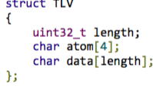
MPEG4 Format

Slide 19
tx3g exploit
status_t MPEG4Source::parseChunk(off64_t *offset) {
[...]
uint64_t chunk_size = ntohl(hdr[0]);
uint32_t chunk_type = ntohl(hdr[1]);
off64_t data_offset = *offset + 8;
if (chunk_size == 1) {
if (mDataSource->readAt(*offset + 8, &chunk_size, 8) < 8) {
return ERROR_IO;
}
chunk_size = ntoh64(chunk_size);
[...]
switch(chunk_type) {
[...]
case FOURCC('t', 'x', '3', 'g'):
{
uint32_t type;
const void *data;
size_t size = 0;
if (!mLastTrack->meta->findData(
kKeyTextFormatData, &type, &data, &size)) {
size = 0;
}
uint8_t *buffer = new (std::nothrow) uint8_t[size + chunk_size];
if (buffer == NULL) {
return ERROR_MALFORMED;
}
if (size > 0) {
memcpy(buffer, data, size);
}
offset into file
int hdr[2] is the first two words read from offset
chunksize of 1 has a special meaning.
chunk_size is uint64_t,
it is read from a file
it is used to allocate a buffer in heap.
All ingredients for an integer overflow vulnerability
Buffer could be made to overflow here. Resulting in a heap based exploit.
This can be used to control … ... Size written
... What is written
... Predict where objects are allocated
https://github.com/CyanogenMod/android_frameworks_av/blob/6a054d6b999d252ed87b4224f3aa13e69e3c56e0/media/libstagefright/MPEG4Extractor.cpp#L1954

Slide 20
Integer Overflows
uint64_t chunk_size = ntohl(hdr[0]);
uint8_t *buffer = new (std::nothrow) uint8_t[size + chunk_size];
On 32 bit platforms
widthness overflow (chunk_size + size) is uint64_t however new takes a 32 bit
value
On 64 bit platforms
arithmetic overflow (chunk_size + size) can overflow by setting large values for chunk_size

